Slide 1
UX design process: Empathize, Define, Ideate

Slide 2
Topics we ’ll learn
How to empathize with users,
Build an empathy map,
Understand user pain points,
Explore personas,
Write user stories,
Identify happy paths and edge cases,
Discover the benefits of user journey maps,
Write problem statements

Slide 3
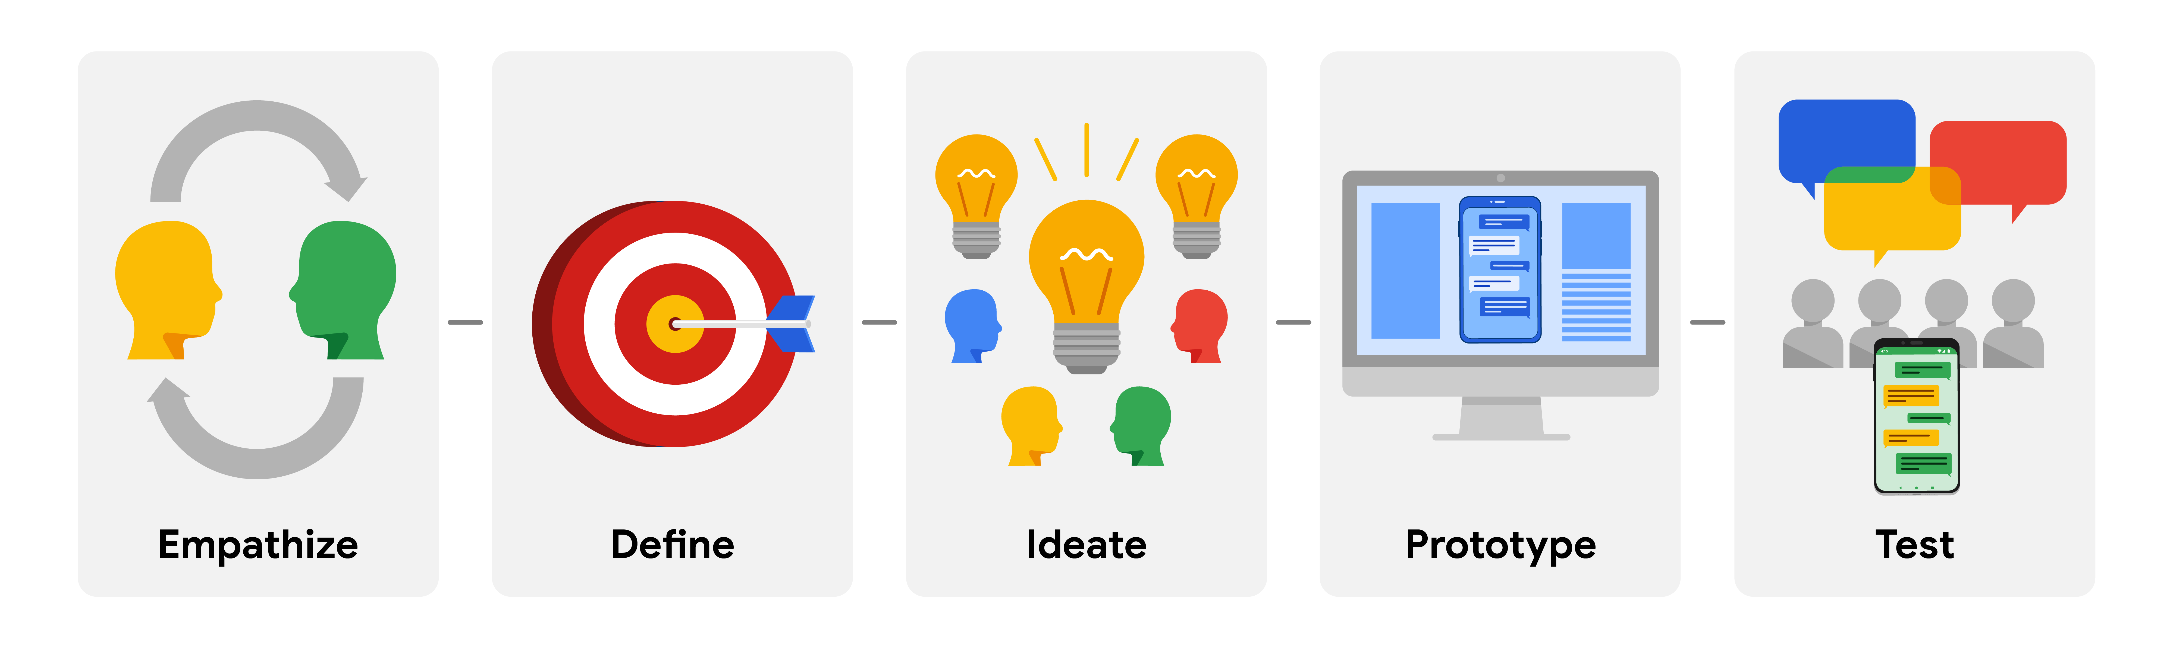
Design Thinking: A UX design framework
The Design Thinking framework is a user-centered approach to problem-solving that includes activities like research, prototyping, and testing.
To help you understand who your user is, what their problems are, and what your design should include.
An iterative, non-linear process contains 5 phases

Slide 4
Empathize with users and Define pain points

Slide 5
Empathize With users
“Empathy is the ability to understand someone else's feelings or thoughts in a situation”.
Empathizing with potential users is important to every step of the design thinking process
UX design is not about solving problems we assume users want solved. It's about solving problems that users actually want solved.

Slide 6
Empathize
Primary goal of empathizing is
Seek to understand how users experience the product they’re designing.
To know their users’ problems and needs,
Want a clear understanding of the situations and environments where users interact with the product
Building on business requirements
To validate, update, and expand on the user information in their project’s business requirements.
By connecting directly with users and researching their experiences

Slide 7
Methods for empathizing with users
Your user research might include
Questionnaires / user surveys,
In-person / Phone / Video interviews
Observation sessions,
Conduct some research on the competitors’ products to determine how your user frames competitors’ products as part of their daily life and daily problem-solving.

Slide 8
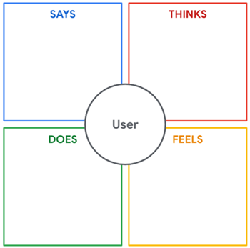
Empathy maps
An empathy map is an easily understood chart that explains everything designers have learned about a type of user
Show what the user thinks, says, does, feels.
Get into the user's mindset, and identify their pain points.

Slide 9
Example In Dog Walker App
Situation: Makayla is a 45-year-old, female-identifying teacher who lives in Houston, Texas. She has two dogs. Makayla has a demanding job as a fourth grade teacher. She also volunteers as a volleyball coach after school. Makayla’s partner works full-time as a pediatric surgeon and regularly switches between working the night-shift and the day-shift at a local hospital.
Notes:
Tình huống: Makayla là một giáo viên nữ 45 tuổi sống ở Houston, Texas. Cô ấy có hai con chó. Makayla có một công việc đòi hỏi khắt khe là một giáo viên lớp bốn. Cô cũng tình nguyện làm huấn luyện viên bóng chuyền sau giờ làm việc. Chồng của Makayla làm việc toàn thời gian với tư cách là một bác sĩ phẫu thuật nhi khoa và thường xuyên chuyển đổi giữa làm ca đêm và ca ngày tại một bệnh viện địa phương.

Slide 10
Identify user pain points
Pain points are any UX issues that frustrate the user and block the user from getting what they need.
Example
Norman Door? If you expect a door to open, it should open. If it doesn't, that's a user pain point.
Ever gone on a company's website to find their customer service info? You click tab after tab, scroll page after page, and you still can't find it?

Slide 11
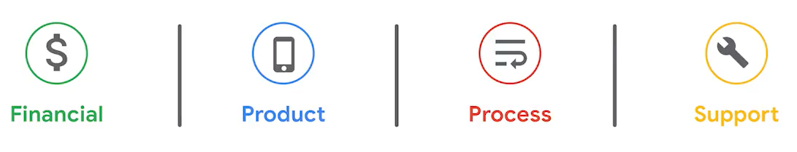
Type of Pain points
Financial pain points: user problems related to money.
Product pain points: quality issues related to the product.
Process pain points: frustrations that stop the user going from point A to point B.
Support pain points: can't find answers to questions

Slide 12
Excercise - Solving user pain points
I need to keep my food cold on a road trip.
Solution: I need a cooler to store and keep my food cold.
I need to make a 1/4 inch hole.
Solution: I need a drill bit.
I need to get from New York to Paris.
Solution: I need an airplane ticket.
I need to connect with my family, located far away.
Solution: I need a video conferencing platform.
I need to stop my leg from bleeding.
Solution: I need a bandage.

Slide 13
Create Personas
Personas are fictional users whose goals and characteristics represent the needs of a larger group of users.
Each personas represent a group of users with similar characteristics that you’ve learned about through your research
Personas can help us identify patterns of behavior in users. These patterns might point to a common pain point that a group of users experiences
Notes:
Personas are not created based on stereotypes but are based on description of the real people you talked to.
You might end up creating multiple personas based on your user research. That way it will capture synthesis of all the people you talked to.

Slide 14
Build Personas
Personas are created by conducting user research and identifying common pain points
Look for the most common themes in your data and group the users who personify those themes together
Ttypes of personas: Goal-directed Personas, Role-Based Personas, Engaging Personas, Fictional Personas
Generally, creating 3 to 8 personas is enough to represent the majority of a product’s user base.

Slide 15
Persona Template
“Relevant personal quote that captures the persona’s attitude and personality”
Add image that represents this persona
Goals
The related objectives this person wants to successfully complete
Frustrations
The issues or pain points that they encounter or try to avoid
Name
Age:
Education:
Hometown:
Family:
Occupation:
Brief story or scenario that conveys the persona’s user journey, highlighting their goals, frustrations, and other relevant context.

Slide 16
Build Personas Example
Imagine you're designing a fundraising app that connects nonprofits with volunteers. You do some secondary research and conduct phone interviews with a diverse set of users. During research, you discover that single professionals in rural areas donate to environmental causes twice as often as single professionals in big cities. You also discover that big city singles are more likely to volunteer than single professionals in rural areas. Based on this, one of your user groups might be owners of environmental nonprofits in rural areas.
A user group is a set of people who have similar interests, goals, or concerns.
Notes:
Hãy tưởng tượng bạn đang thiết kế một ứng dụng gây quỹ kết nối các tổ chức phi lợi nhuận với tình nguyện viên. Bạn thực hiện một số nghiên cứu và các cuộc phỏng vấn qua điện thoại với nhiều người dùng khác nhau. Trong quá trình nghiên cứu, bạn phát hiện ra rằng các chuyên gia độc thân ở khu vực nông thôn quyên góp cho các nguyên nhân môi trường thường xuyên gấp đôi so với các chuyên gia độc thân ở các thành phố lớn. Bạn cũng khám phá ra rằng những người độc thân ở thành phố lớn có nhiều khả năng tham gia tình nguyện hơn các chuyên gia độc thân ở khu vực nông thôn. Dựa trên điều này, một trong những nhóm người dùng của bạn có thể là chủ sở hữu của các tổ chức phi lợi nhuận về môi trường ở khu vực nông thôn.

Slide 17
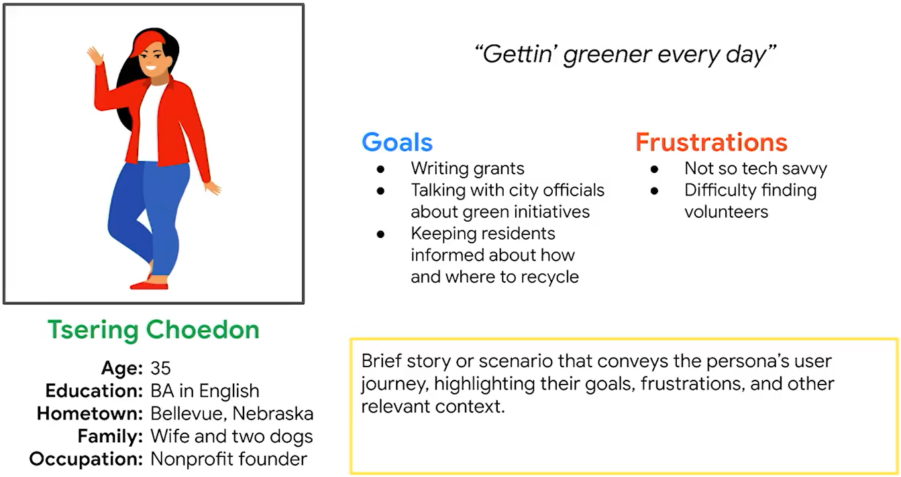
Tsering Choedon Persona

Slide 18
Persona of Dog Walker app Example
Daniela is a 48-year-old freelance film producer who lives with their partner Priya and their two children in Atlanta, Georgia. The family recently adopted a golden retriever puppy named Cisco.
The family takes regular trips with the kids for gymnastics competitions, and Daniela often travels for long periods of time when filming. Daniela wants to find someone to take care of the puppy, Cisco, while the family is away or busy.
Daniela’s biggest concern is trusting a stranger to come into their home and to take care of their puppy. Daniela would be most comfortable hiring someone who knows how to properly care for puppies and can take Cisco on walks and to dog parks.
Notes:
Daniela là một nhà sản xuất phim tự do 48 tuổi, sống với người bạn đời Priya và hai con của họ ở Atlanta, Georgia. Gia đình gần đây đã nhận nuôi một chú chó săn mồi vàng tên là Cisco.
Gia đình thường xuyên đi du lịch với bọn trẻ cho các cuộc thi thể dục dụng cụ, và Daniela thường đi du lịch trong thời gian dài khi quay phim. Daniela muốn tìm ai đó để chăm sóc chú chó con, Cisco, trong khi gia đình đi vắng hoặc bận rộn. Mối quan tâm lớn nhất của Daniela là tin tưởng một người lạ vào nhà và chăm sóc chú chó con của họ. Daniela sẽ cảm thấy thoải mái nhất khi thuê một người biết cách chăm sóc chó con đúng cách và có thể đưa Cisco đi dạo và đến công viên dành cho chó.

Slide 19
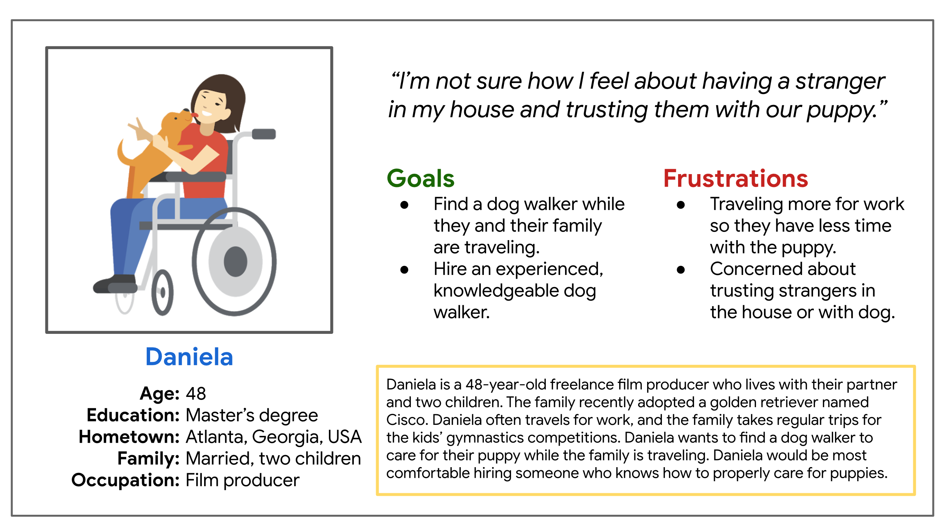
Daniela Persona example

Slide 20
CoffeeHouse Business Scenario
CoffeeHouse is an international coffee store chain with locations in New York, Chicago, San Francisco, Cleveland, London, Nantes, Reykjavik, and more. It aims to serve quality coffee with local flair. Their drinks range from $3 - $8. The shops are minimalist, clean-lined, and feature a variety of freshly brewed house blends from the world’s major coffee regions. They offer both ready-to-drink and whole or ground beans by the pound. Their specialty drinks are made to order at their counter. For each of the cities they currently operate in, they have crafted an exclusive coffee-based beverage that can only be ordered in its city. This has inspired fans to seek out CoffeeHouse shops in other cities in an effort to try all of the exclusive creations.
Services:
A counter where CoffeeHouse baristas make drinks to order.
A selection of pastries and scones sourced locally from the cities they operate in, but made to CoffeeHouse specifications.
Notes:
CoffeeHouse là một chuỗi cửa hàng cà phê quốc tế với các địa điểm ở New York, Chicago, San Francisco, Cleveland, London, Nantes, Reykjavik, v.v. Nó nhằm mục đích phục vụ cà phê chất lượng với sự tinh tế địa phương. Đồ uống của họ dao động từ $ 3 - $ 8. Các cửa hàng tối giản, sạch sẽ và có nhiều hỗn hợp nhà mới pha từ các vùng cà phê lớn trên thế giới. Họ cung cấp sẵn sàng để uống và nguyên hạt hoặc xay theo pound. Đồ uống đặc sản của họ được sản xuất để đặt hàng tại quầy của họ. Đối với mỗi thành phố mà họ hiện đang hoạt động, họ đã tạo ra một loại đồ uống độc quyền dựa trên cà phê chỉ có thể được đặt hàng trong thành phố của nó. Điều này đã truyền cảm hứng cho người hâm mộ tìm kiếm các cửa hàng CoffeeHouse ở các thành phố khác trong nỗ lực thử tất cả các sáng tạo độc quyền.
Dịch vụ:
Một quầy nơi các barista của CoffeeHouse pha chế đồ uống để gọi món.
Một lựa chọn các loại bánh ngọt và bánh nướng có nguồn gốc địa phương từ các thành phố mà họ hoạt động, nhưng được sản xuất theo thông số kỹ thuật của CoffeeHouse.

Slide 21
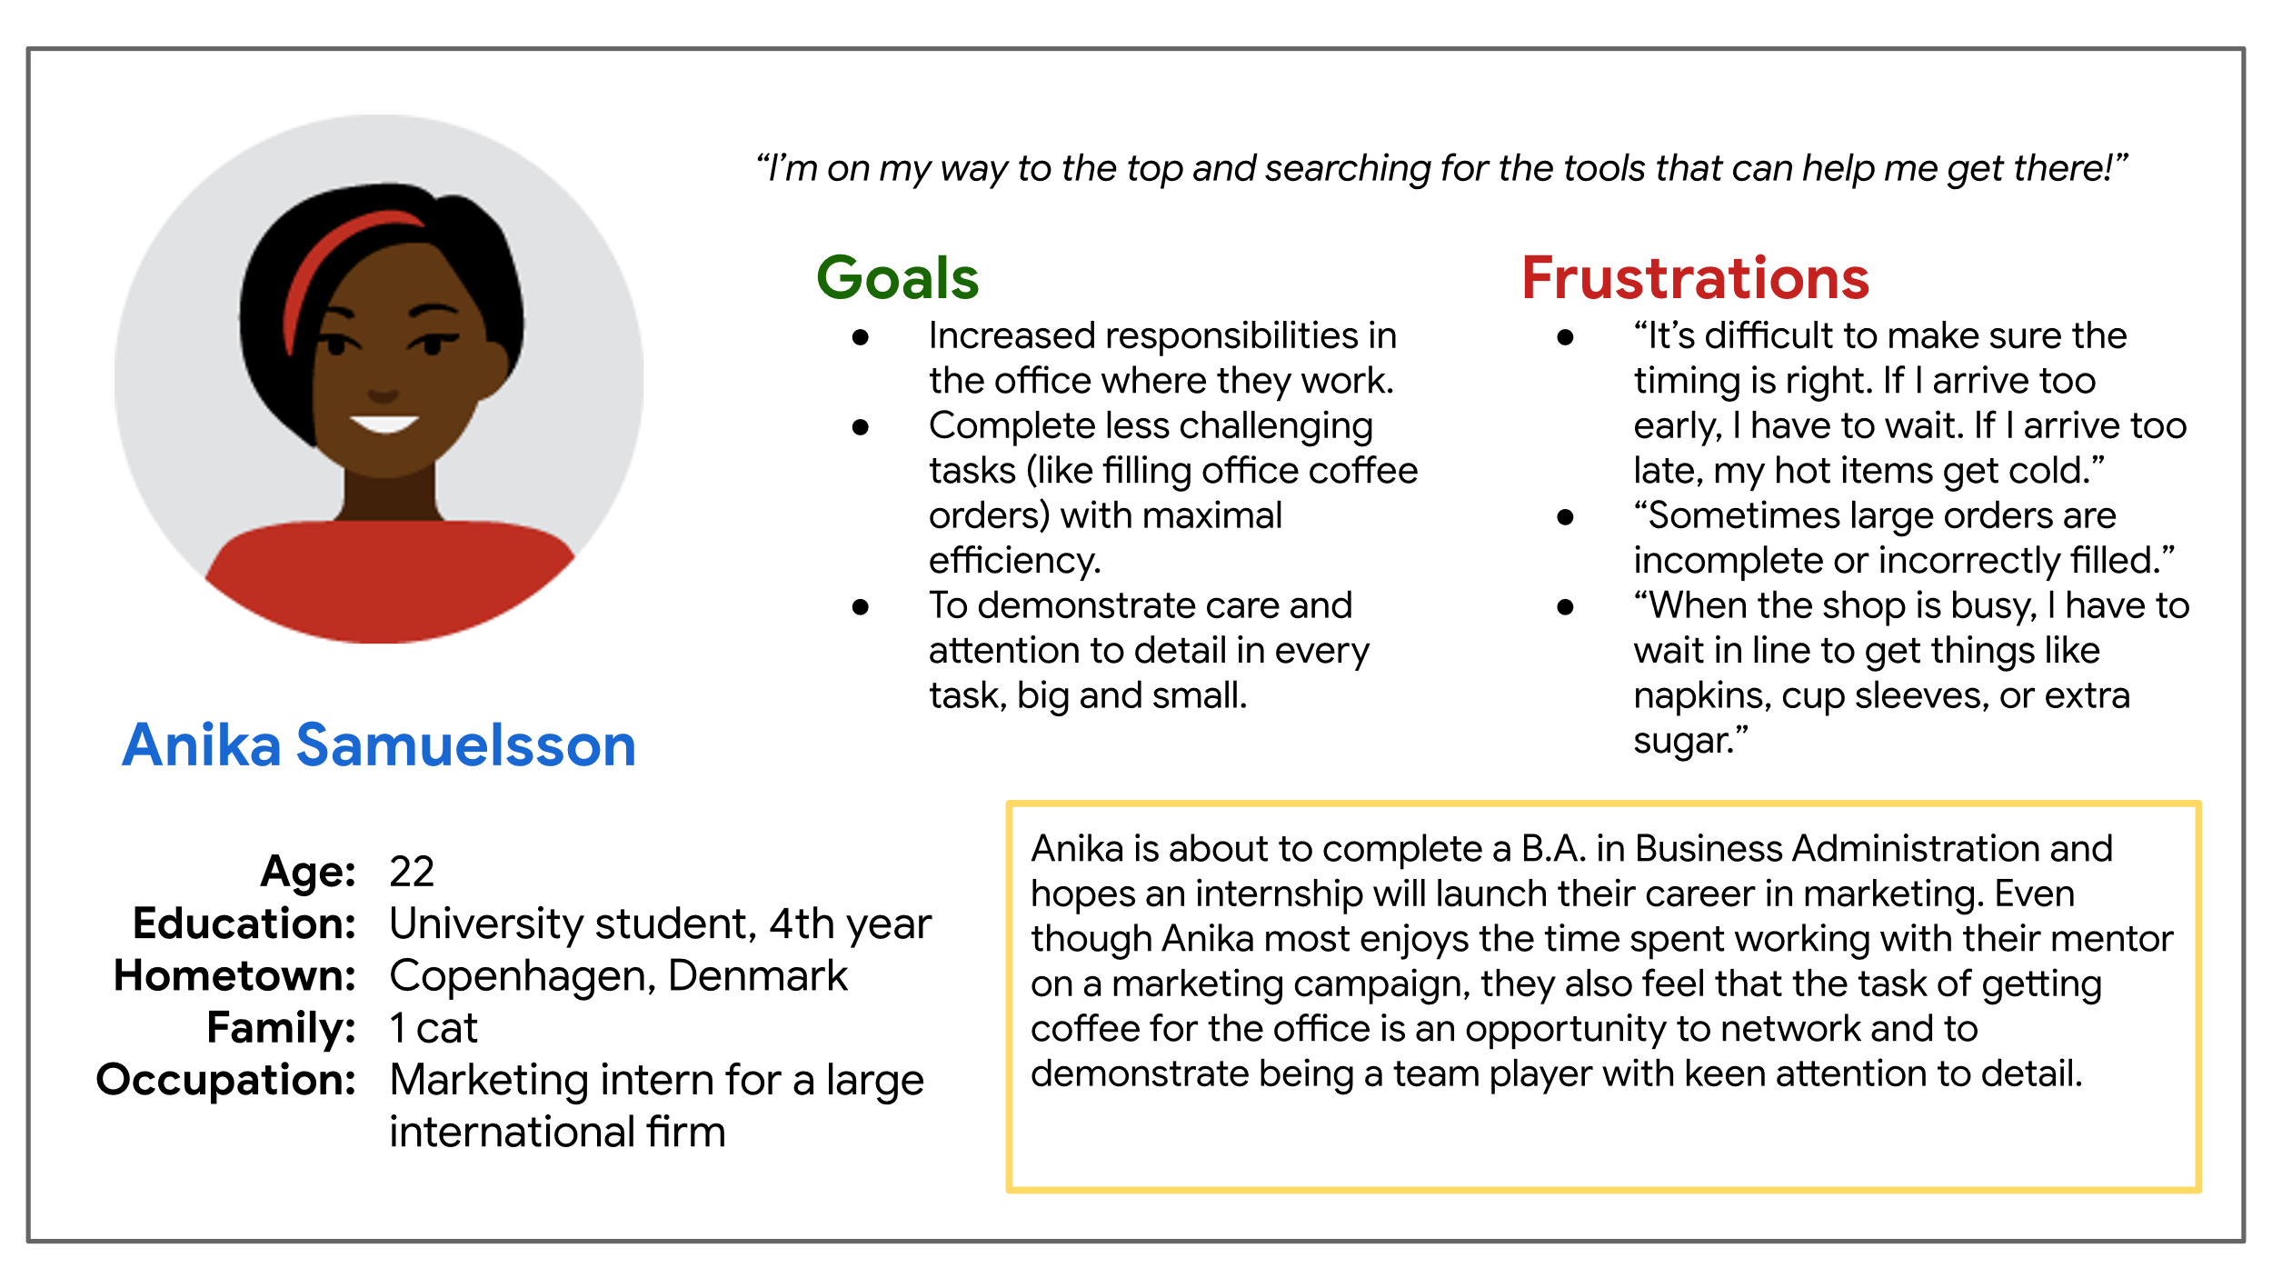
Persona for the CoffeeHouse project Persona 1: Anika, ambitious intern: Busy junior employee seeking quick and efficient pick-up service.

Slide 22
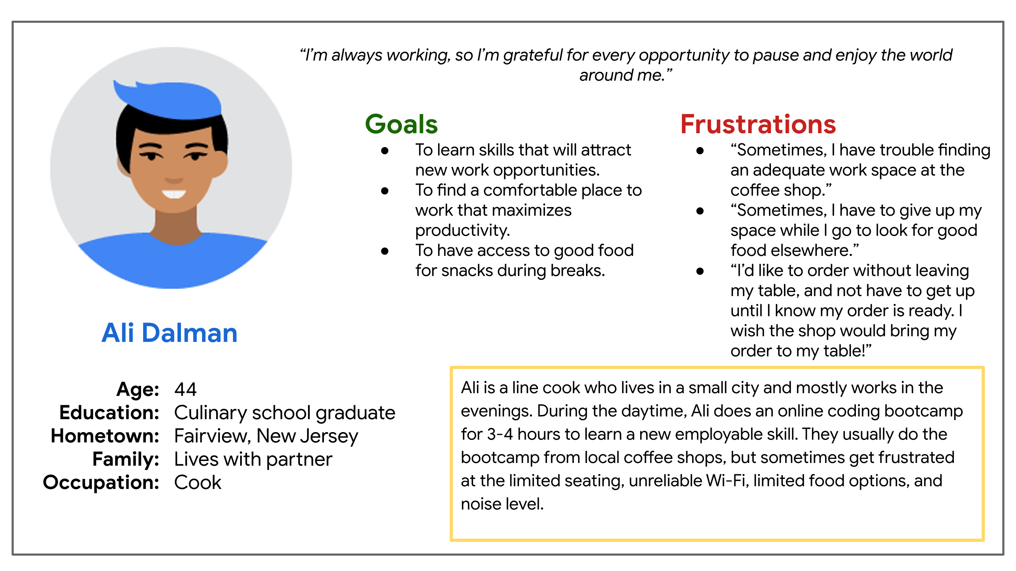
Persona for the CoffeeHouse project Persona 2: Ali, remote upskiller: In-store customer who wants to enjoy CoffeeHouse items and its atmosphere in a way that allows them to be connected and productive

Slide 23
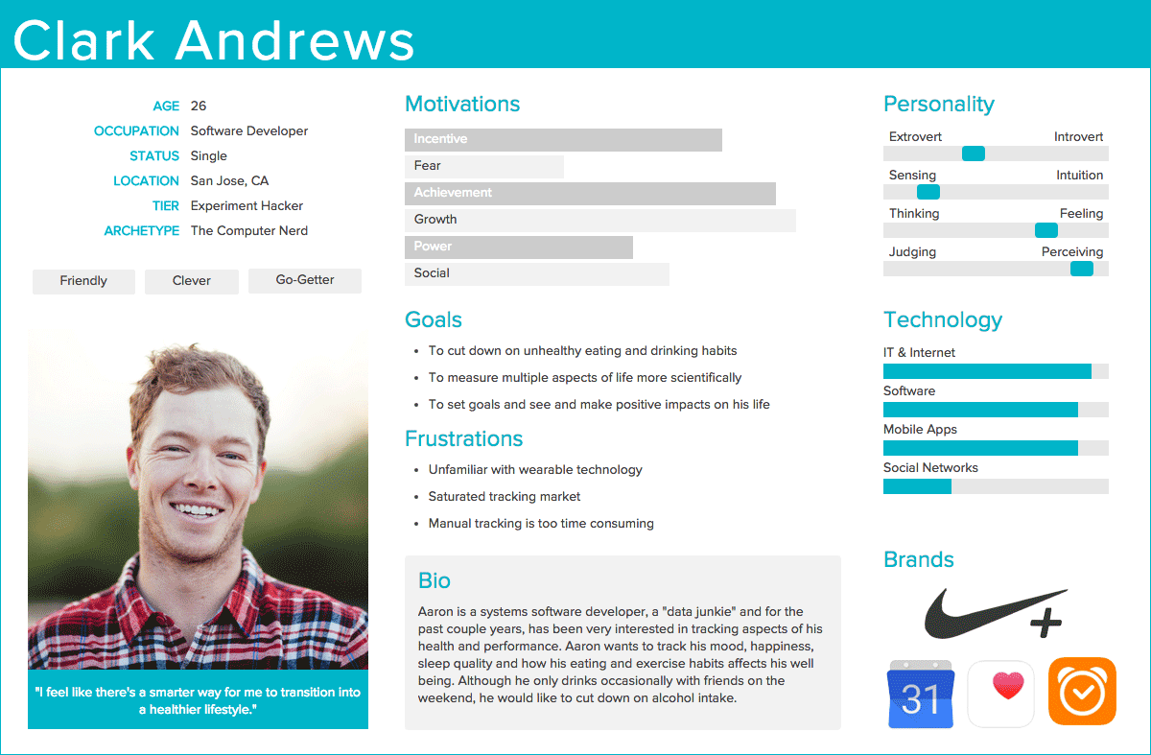
Other Persona template

Slide 24
Benefits of Personas
Build empathy
Personas encourage empathy and put a face to the user. They help humanize our users. They give stakeholders a clearer idea of who their users really are and makes the user experience more meaningful
Tell stories
Need a set of personas to tell all sides of a design story. All user groups should be vividly represented. This shows the diversity of their user groups, and it lets you test features against them.
Stress-test designs
Create a design that benefits a wide range of users.

Slide 25
Create User Story and User Journey Map

Slide 26
User Story
A is a fiction alone-sentence story told from a persona's point of view to inspire and inform design decisions.
Highlight a user problem or need so that software developers can determine which features to prioritize and build into a product.
Describe functionality, or the feature desired from the point of view of the user
Also called scenarios or user cases

Slide 27
Advantages of User Story
Prioritize design goals.
If you have a lot of user needs to consider, user stories, determine which ones are the most critical to resolve.
Unite the team around a clear goal.
Inspire empathetic design decisions by making our approach user-centered.
Personalize pitches to stakeholders
Not just pitching your ideas for design updates, also showcasing how it will help specific groups of people.

Slide 28
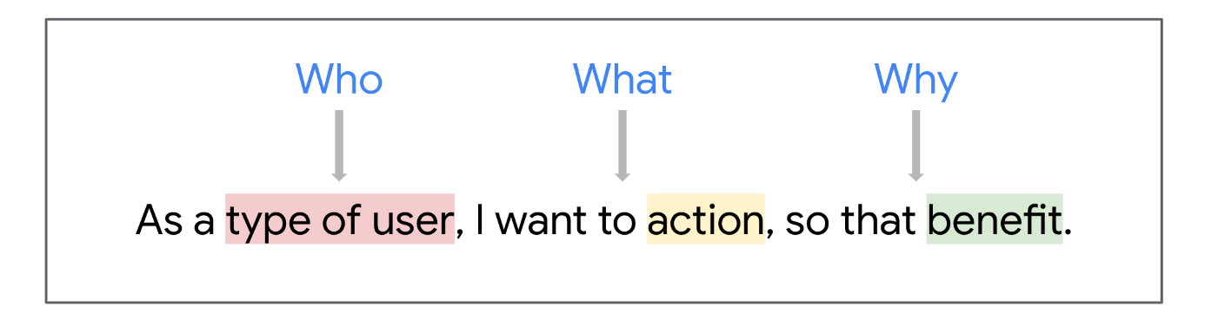
User story format
Type of user describes who we're developing the product for
Action is what the user hopes will happen
Benefit is why the user wants the action to happen
This user-centric, actionable, clear format ensure:
Communicating everything to know about the persona.
Addressing and solving the key problems your users might face when engaging with your product.

Slide 29
User story format
USER STORY
As a/an
[add persona]
type of user
I want to
action
.
so that
benefit

Slide 30
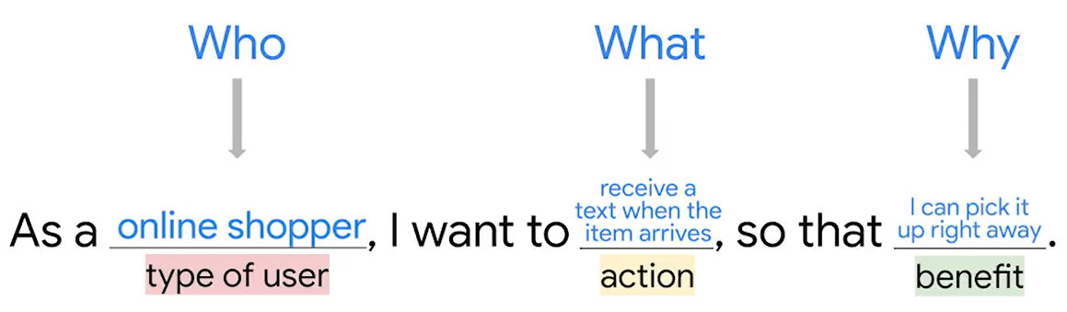
Example

Slide 31
User stories of the Dog Walker app
Makala Scott: As a frequent traveler, I want to hire a consistent dog walker so that I can feel comfortable about the safety of my pets while I'm on vacation.
Tobias Clark: As a dog owner, I want to trust my dog walker so I can hire them for regular dog walks.
Darlene Wu: As a busy executive, I want to trust that dog walkers won't stand me up so I can work worry-free.

Slide 32
User stories of the dog walker app
Carlos Bernal: As an indecisive student, I want to try many walkers so I can pick one for regular walks.
Daniella Ortega: As a mother of two, I want to limit the amount of access to my home so I can keep my family safe.
Jessica Banks: As a former police officer, I want to track my dog walker so I am comfortable with the safety of my pets.
Arnold Jones: As a widowed executive, I want to find a permanent dog walker so my pets get the care they deserve.

Slide 33
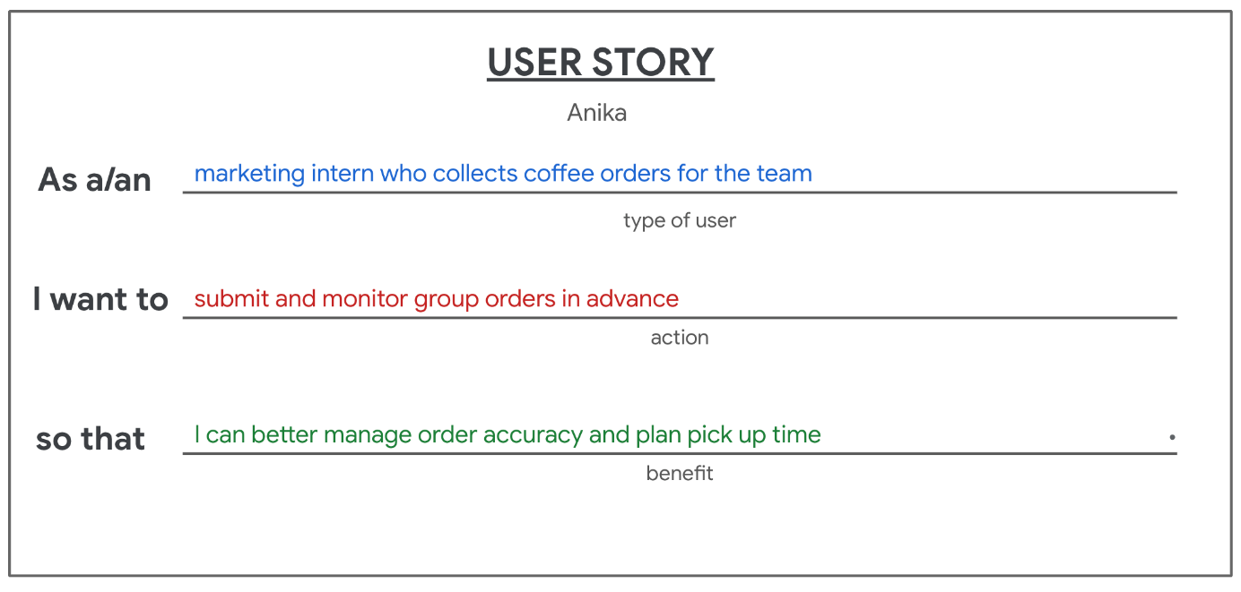
User stories of the Coffee House
Anika is a marketing intern at a midsized advertising firm. Twice a week, they collect 6-12 coffees from a nearby coffee shop for their team before their morning meeting. But sometimes they find that their order is incomplete or has gotten cold from waiting too long for them to pick it up. They need a way to place an order in advance, track order status, and better plan their arrival for pick-up

Slide 34
Consider edge cases
With user stories, there's always a chance that things will not go exactly the way you want them to, but you can always change the user experience.
When developing a new or improved product, the designer's goal is to keep all users on a happy path
The happy path describes a user story with a happy ending. => Go as expecting and reach to goal without issue.
An edge case is a rare situation or unexpected problem that interrupts a standard user experience
Good UX anticipates edge cases and reroute users back to the happy path when things don't go as planned.

Slide 35
Tips on how to avoid and resolve potential edge cases
Create personas and user stories
Account for a wide variety of users and issues, can keep even the most vulnerable users on a good path.
Thoroughly review the project before launching.
Giving the project a final good review from the user's perspective, helps designers identify edge case.
Always use wireframes
Help visualize the whole project, which makes it easier to identify potential user pain points (edge cases) and fix them before launch.

Slide 36
Create a user journey map
A user journey is the series of experiences a user has as they achieve a specific goal.
User journeys built off the personas and stories.
A journey map visualizes how a user interacts with a product by recording the actions they take to achieve a goal.
Outline key events, user motivations, and friction points within their experience
Visualizes the actual process users go through from the first touchpoint to the last.

Slide 37
Benefits of User Journey Mapping
Help to create obstacle-free paths for users
Reduces the impact of designer bias
Thoroughly document the entire sequence of events and interactions a user experiences, including the user’s interaction with your design. That way you can really focus on how a specific persona, not you, thinks and feels at every step of the journey.
Highlights new pain points
Identify improvement opportunities

Slide 38
Create a comprehensive journey map
Define your persona
A user journey map is always focused on the experience of one main user persona.
Understand the goals of your users
Define scenario and user expectations
Map out touchpoints
User actions and interactions with the product/business on associated channels
Consider a user’s emotional state during each step of interaction
Identity user pain points
Prioritize and remove obstacles
Update and improve

Slide 39
User Journey Map Example
Persona: Jamal
Goal: Find a subway route that will take him to the Empire State Building

Slide 40
Step 1: Add each action in the journey until the user reaches their goal
Persona: Jamal Goal: Find a subway route that will take him to the Empire State Building
ACTION | Determine the subway line and route | Find the nearest station with wheelchair accessibility | Buy a ticket | Find the right platform | Board the subway | Find the right exit
TASK LIST
FEELING ADJECTIVE
IMPROVEMENT OPPORTUNITIES

Slide 41
Step 2: Add descriptions for each action What tasks does the user have to do?
Persona: Jamal Goal: Find a subway route that will take him to the Empire State Building
ACTION | Determine the subway line and route | Find the nearest station with wheelchair accessibility | Buy a ticket | Find the right platform | Board the subway | Find the right exit
TASK LIST | A. Find and read subway map B. Identify fastest route C. Use map app | A. Use map app B. Check station accessibility C. Get to station | A. Find accessible kiosk B. Determine ticket to buy C. Pay for ticket | A. Follow signs B. Find the line number or letter C. Go uptown D. Find elevator | A. Find space for wheelchair | A. Open map app to find exit to use B. Follow signs
FEELING ADJECTIVE
IMPROVEMENT OPPORTUNITIES

Slide 42
Step 3: Add how the user feels at each point. Guesstimates are okay!
Persona: Jamal Goal: Find a subway route that will take him to the Empire State Building
ACTION | Determine the subway line and route | Find the nearest station with wheelchair accessibility | Buy a ticket | Find the right platform | Board the subway | Find the right exit
TASK LIST | A. Find and read subway map B. Identify fastest route C. Use map app | A. Use map app B. Check station accessibility C. Get to station | A. Find accessible kiosk B. Determine ticket to buy C. Pay for ticket | A. Follow signs B. Find the line number or letter C. Go uptown D. Find elevator | A. Find space for wheelchair | A. Open map app to find exit to use B. Follow signs
FEELING ADJECTIVE | Confused Intimidated | Lost Hopeful | Confused Satisfied | Overwhelmed Excluded | Relieved Glad Alert | Excited Confused
IMPROVEMENT OPPORTUNITIES

Slide 43
Step 4: Add opportunities for improvement This is where new ideas may come from!
Persona: Jamal Goal: Find a subway route that will take him to the Empire State Building
ACTION | Determine the subway line and route | Find the nearest station with wheelchair accessibility | Buy a ticket | Find the right platform | Board the subway | Find the right exit
TASK LIST | A. Find and read subway map B. Identify fastest route C. Use map app | A. Use map app B. Check station accessibility C. Get to station | A. Find accessible kiosk B. Determine ticket to buy C. Pay for ticket | A. Follow signs B. Find the line number or letter C. Go uptown D. Find elevator | A. Find space for wheelchair | A. Open map app to find exit to use B. Follow signs
FEELING ADJECTIVE | Confused Intimidated | Lost Hopeful | Confused Satisfied | Overwhelmed Excluded | Relieved Glad Alert | Excited Confused
IMPROVEMENT OPPORTUNITIES | Better wayfinding | Better wayfinding Accessibility key on map app | Ticket explanations | Better wayfinding Designated walk lanes | Phone vibrates to inform user when to get off of subway | Signs mention landmarks (not corner)

Slide 44
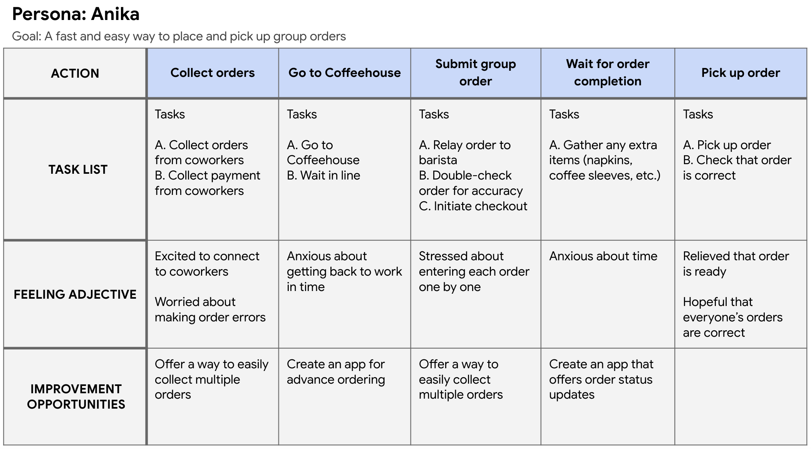
Example: User Journey Map for the CoffeeHouse project

Slide 45
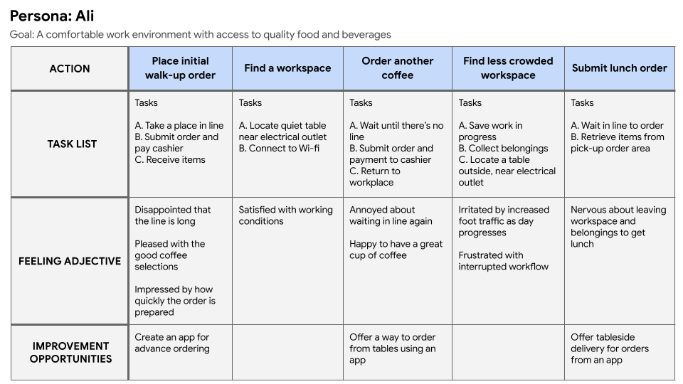
Example: User Journey Map for the CoffeeHouse project

Slide 46
Define User Problem

Slide 47
Problem statement
A problem statement is a clear description of the user's needs that should be addressed.
Problem statements align the team on which user problem to focus on, giving everyone a clear goal.
A strong problem statement
human-centered
broad enough to allow for some creative freedom
narrow enough that it can actually be solved by a design solution.

Slide 48
Define a problem statement
Identifying the problems users face is one of the most important parts of UX design.
Connecting between pain points and problem statements
Minimizing pain points keeps users happy and encourages them to continue use the product
The most common framework used to create problem statements is the 5 Ws and H framework

Slide 49
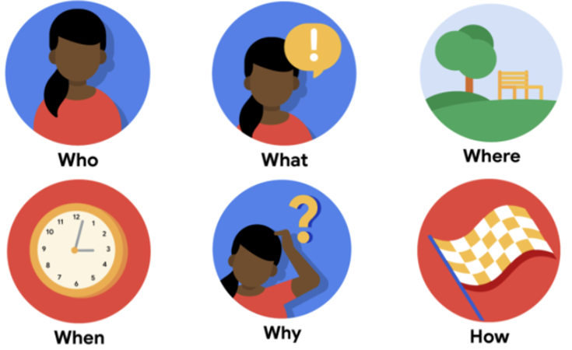
5 Ws and H framework
Who is experiencing the problem?
What are the pain points you’re trying to solve?
Where is the user when they’re using the product?
When does the problem occur?
Why is the problem important?
How are users reaching their goals by using the product?

Slide 50
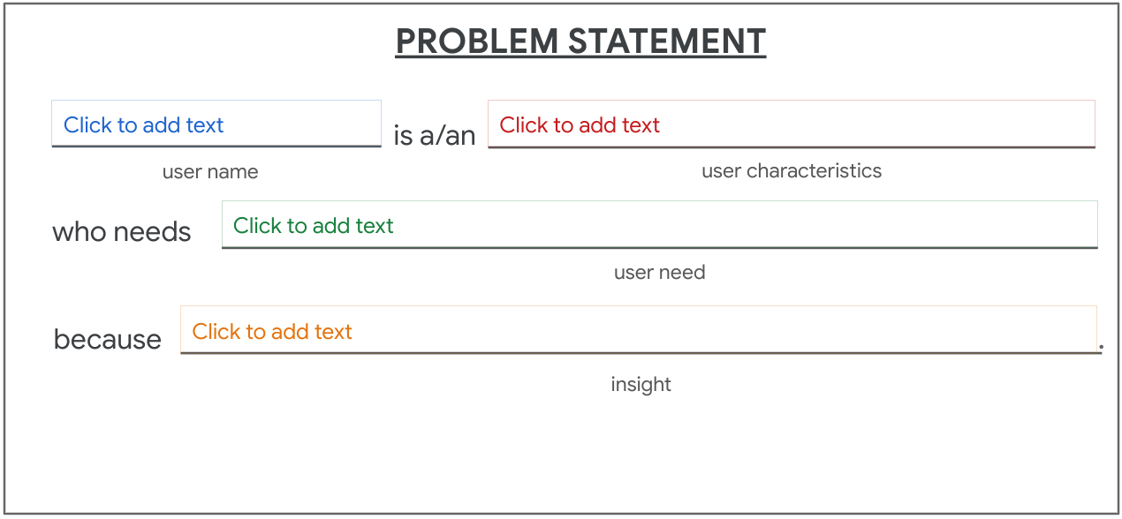
The problem statement format
Describe the user's need and explain why the user has that need – an insight about the user

Slide 51
Example: The dog walker app
Arnold is in his late fifties, and his kids have encouraged him to upgrade to a smartphone. Arnold is a leader at his company, and not used to admitting he's uncomfortable with technology. After his wife died, Arnold became the primary caregiver of the family's animals. But, he works over sixty hours per week, and is unable to take his three dogs on twice-daily walks. Arnold is turning to the dog walker app for help.
Notes:
Arnold đã ngoài năm mươi, và các con của ông đã khuyến khích ông nâng cấp lên điện thoại thông minh. Arnold là một nhà lãnh đạo tại công ty của mình và không quen thừa nhận rằng ông không thoải mái với công nghệ. Sau khi vợ qua đời, Arnold trở thành người chăm sóc chính cho các con vật của gia đình. Nhưng, ông ta làm việc hơn sáu mươi giờ mỗi tuần và không thể đưa ba con chó của mình đi dạo hai lần mỗi ngày. Arnold đang chuyển sang ứng dụng dắt chó đi dạo để được giúp đỡ.

Slide 52
Answer the 5 Ws and H question
Who: A busy executive
What: Arnold wants to hire a daily dog walker for his three dogs.
Where: Arnold is likely using the app at work, on the go.
When: Arnold gets frustrated when he opens the app, starting from the very beginning of the user journey.
Why: Arnold doesn’t have a lot of experience with phone apps or similar technology.
How: Arnold wants to go easily from the home screen of the app to the list of dog walkers to the confirmation screen.

Slide 53
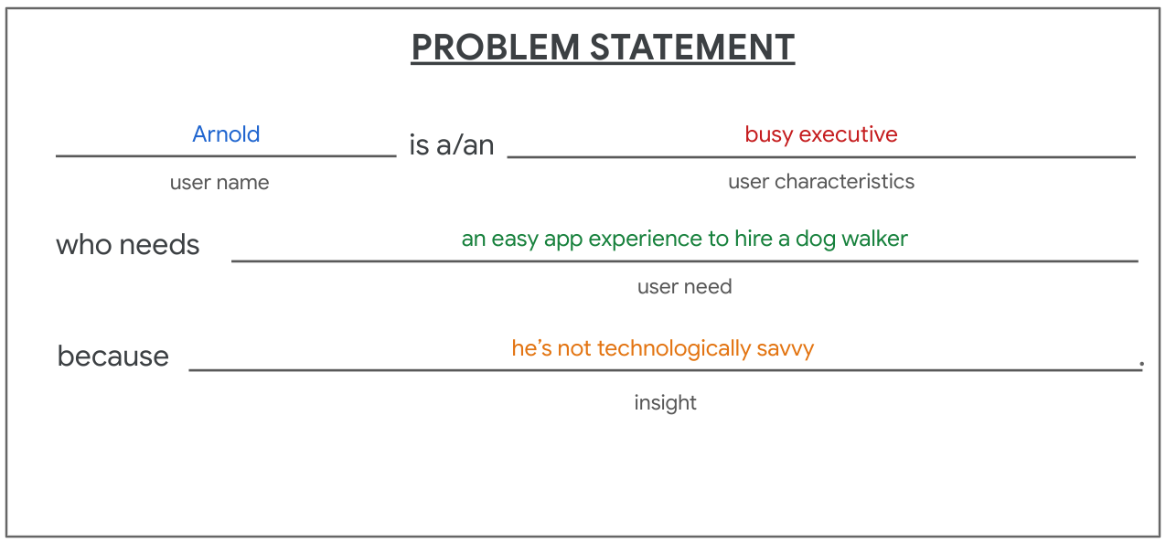
Problem Statement Example
Arnold is a busy executive who needs an easy app experience to hire a dog walker because he's not technologically savvy.

Slide 54
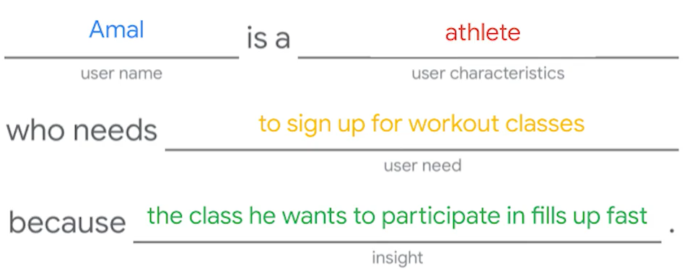
Problem Statement Example

Slide 55
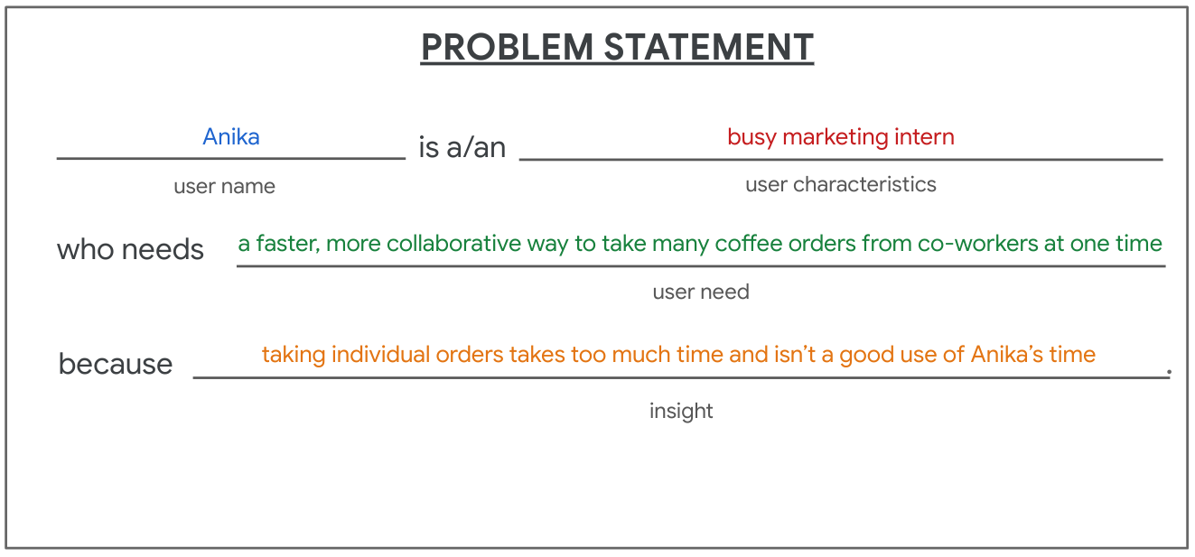
Problem Statement for CoffeeHouse
Anika is a/an busy marketing intern who needs a faster, more collaborative way to take many coffee order from co-workers at one time because taking individual orders takes too much time and isn't a good use of Anika's time.

Slide 56
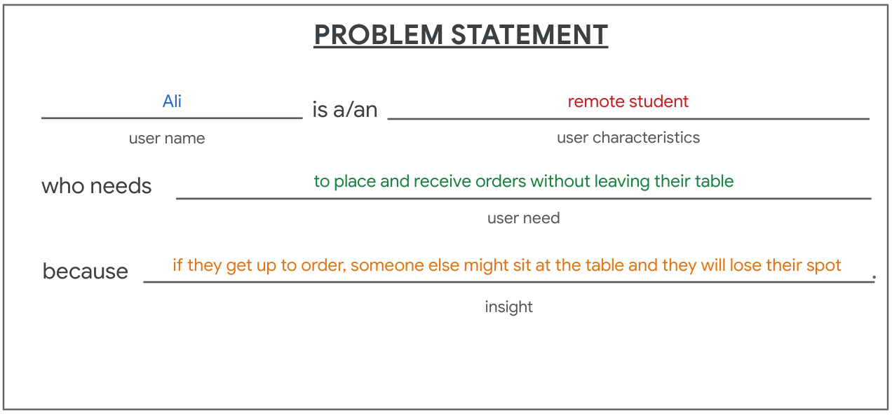
Problem Statement for CoffeeHouse
Ali is a/an remote student who needs to place and receive order without leaving their table because if they get up to order, someone else might sit at the table and they will lose their spot.

Slide 57
Effective problem statement
Establish goals.
Tells you what the user really needs. Defining the goal clearly and concisely gets everyone on the design team onboard and focused on the same thing.
Understand constraints.
What's keeping users from satisfying their needs.
Define deliverables.
What our solution will produce.
Create benchmarks for success.
How will we know when we succeed?

Slide 58
Design ideation

Slide 59
Ideation
Ideation can be defined as the process of generating a broad set of ideas on a given topic with no attempt to judge or evaluate them.
The broad set of ideas part is really important. We need to be able to explore all ideas without judging them and throwing them out. Some of the most crazy ideas can actually prove to be really valuable

Slide 60
Ideation in the real world
Brainstorms out loud
Document all ideas, on sticky notes or a white board
Focus on quantity: share as many ideas as possible
Do not allow evaluation
Gather a diverse team for different backgrounds and perspectives
Question the obvious
Evaluate the ideas

Slide 61
Evaluate the ideas
Is the idea feasible? Is it technically possible to build?
Is the idea desirable? Does it solve the user problem you're focusing on?
Is your idea viable? Is it financially beneficial for the business?
If an idea meets these three criteria, it might be a good option to move forward with

Slide 62
Methods of Ideation
Using insights from competitive audits
Using "How Might We?" exercise to approach the ideation process
Crazy Eights design exercises

Slide 63
How Might We?"
“How Might We” is a design thinking activity used to translate problems into opportunities for design
"how" encourages us to explore a bunch of ideas instead of moving forward with only one idea for the solution.
"might" emphasizes that our ideas are possible solutions, not the only solution.
"we" suggests a collaborative effort. Coming up with ideas requires teamwork

Slide 64
Example
Problem: Olivia is a parent who needs a way to ride her bike with her 2-year-old Luca because he can't ride his own bike.
Let's try coming up with a lot of potential solutions
How might we design a seat for a child to ride a bike with an adult? fairly broad question
How might we design a safe, forward-facing seat that attaches to adult's bicycle, so that a child can choose to ride or sleep while an adult rides on a mountain trail? too specific
How might we design a safe and comfortable seat for a child to ride a bike with an adult? Specific and enough broad

Slide 65
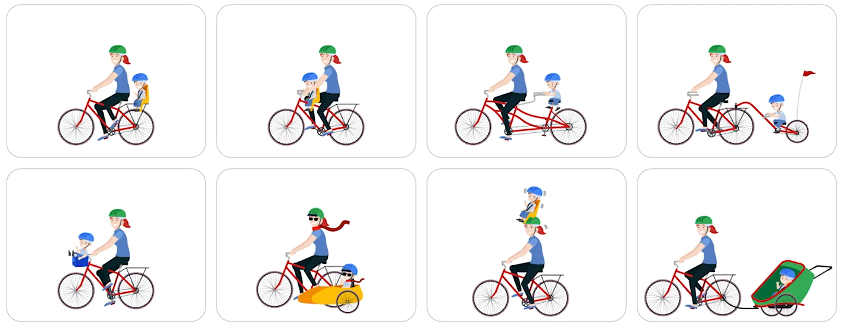
Some Ideas with “How might me”

Slide 66
Ways to create How Might We phrases
Amp up the good
How might we createa traveling experience for a parent and child to enjoy together?
Explore the opposite
How might we design a bike for a 2-year-old to ride with an adult, instead of our original framing of an adult who wants to ride a bike with a 2-year-old?
Change a status quo.
How might we improve public transportation options in Olivia's hometown so that she has options other than biking?
And break the point of view into pieces.
How might we make a 2-year-old comfortable on a bike? How might we easily travelfrom point A to point B?

Slide 67
Crazy Eight exercise
A quick, simple sketches in the ideation process
The point of sketching is to move as quickly as possible to record lots of ideas
Sketch by hand because our hands want to move faster than our brains
Sketching by hand is a valuables kill for you to master
Crazy eights lets you compare ideas, see everyone's different ideas, and narrow down the list of ideas before moving on with the best solutions

Slide 68
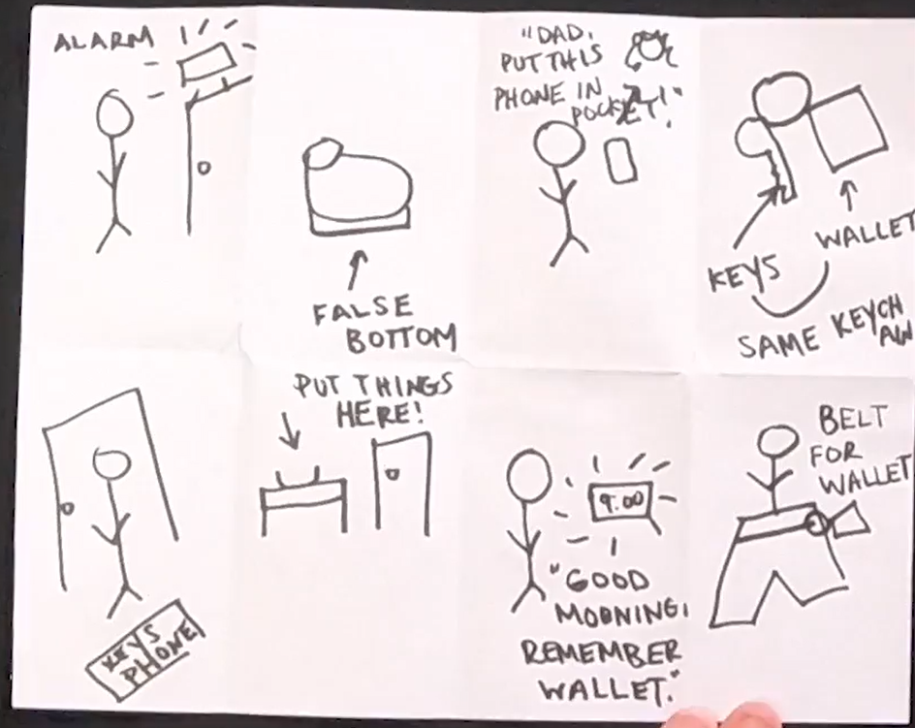
Example with Crazy Eight sketch
Problem statement: Charles is a retired grandfather who needs a way to keep his essential belongings with him because he often loses track of his wallet
Notes:
Sketch 1, an alarm that goes off as Charles opens and closes his house's exterior doors to remind him to bring certain belongings, like his wallet, keys, and phone.
Sketch 2, a sign on his front door that says, remember to take these things with you, place them here when you get home.
Sketch 3, a doormat with a checklist that says, phone, keys, and wallet.
Sketch 4, and my personal favorite, shoes with false bottoms tha the can keep a wallet in

